Slide 1

SierraWave Energy Holdings
Portfolio Map

Slide 2
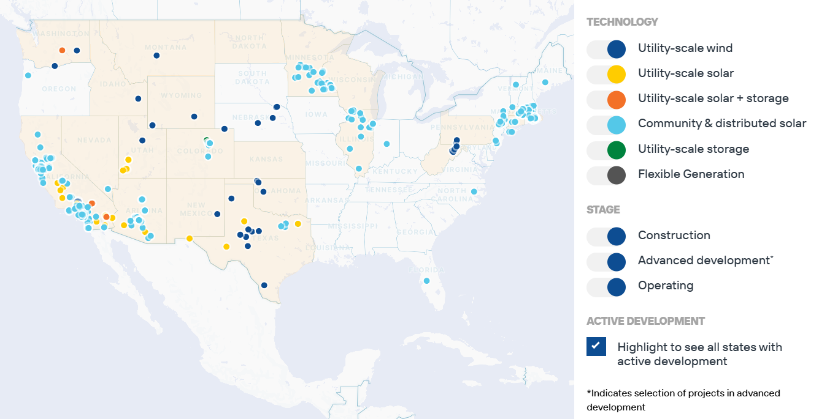
Portfolio Map: Total

Slide 3
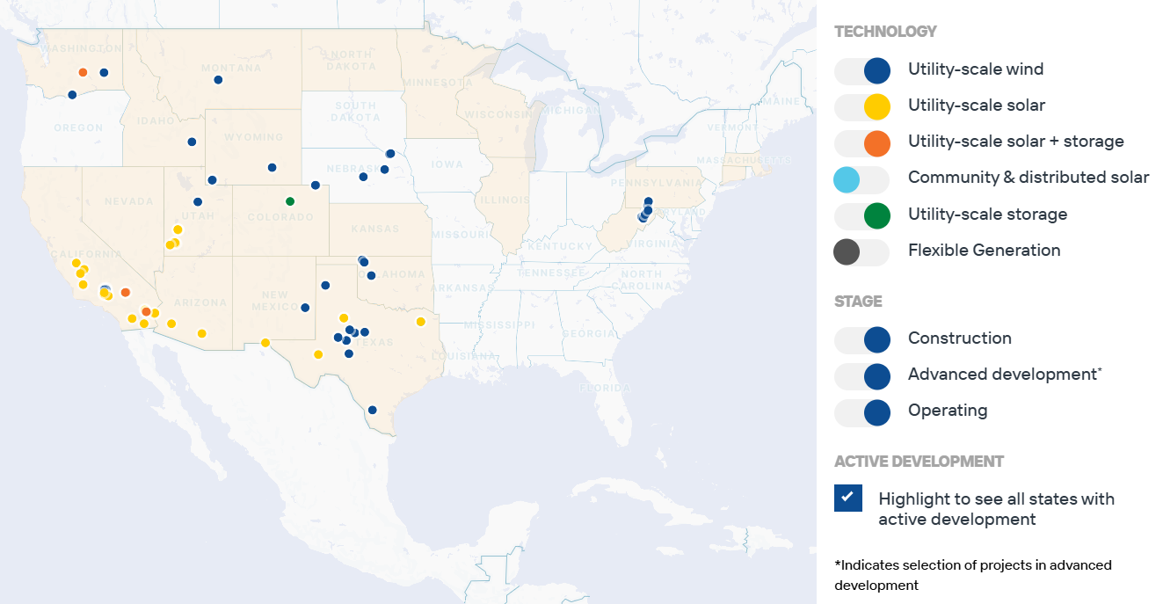
Portfolio Map: Utility-Scale, Total

Slide 4
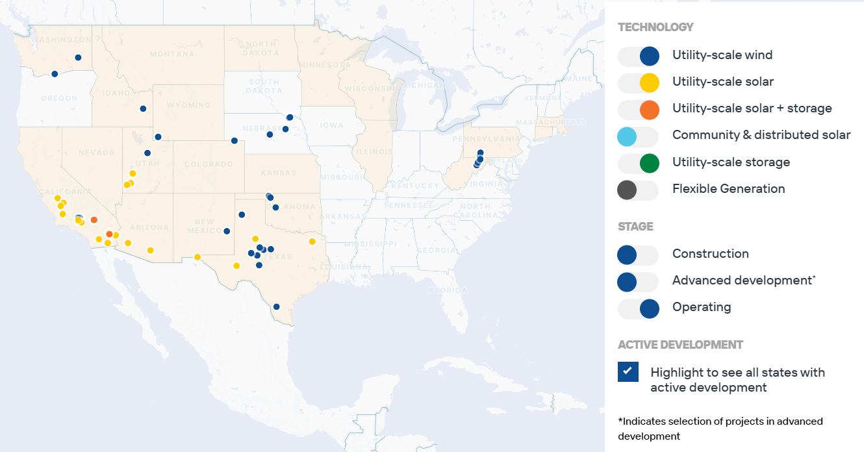
Portfolio Map: Utility-Scale, Operating

Slide 5
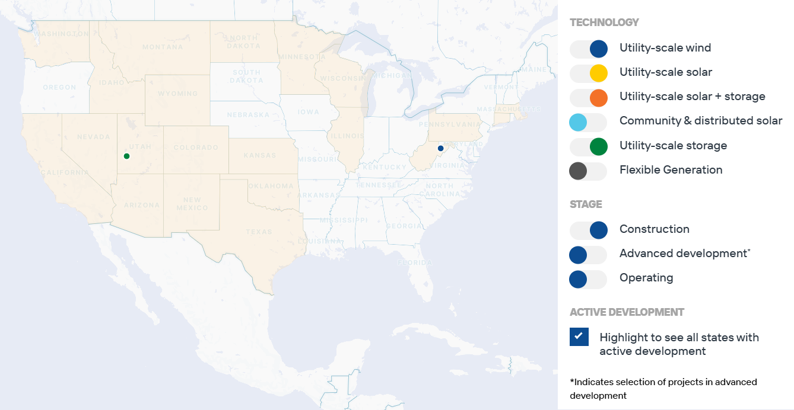
Portfolio Map: Utility-Scale, Construction

Slide 6
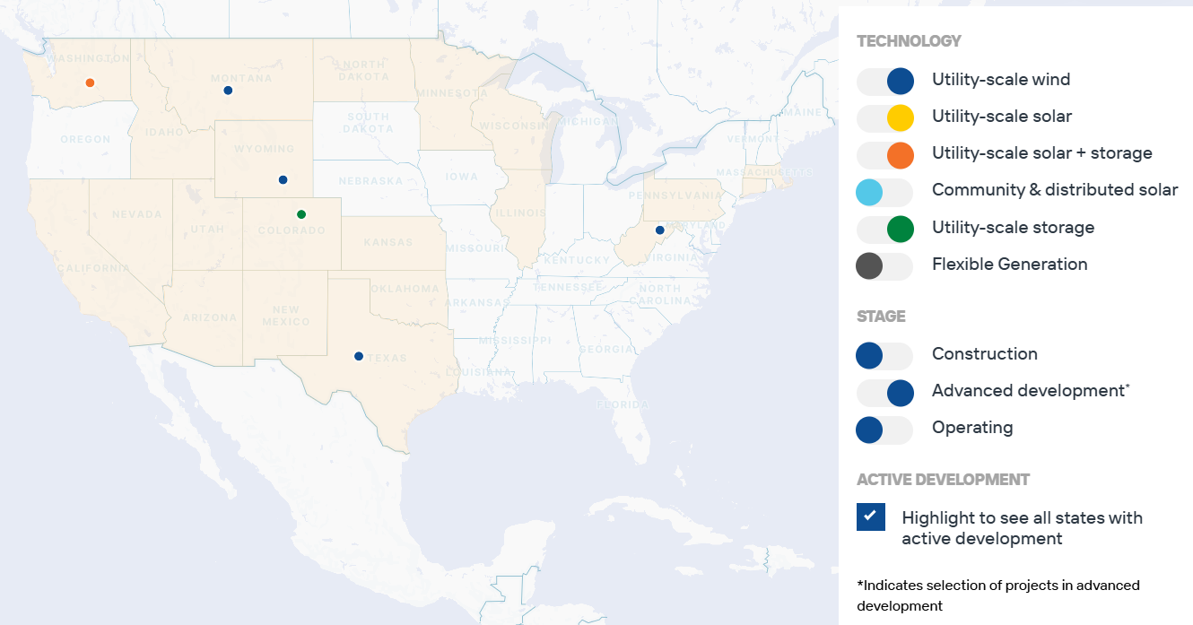
Portfolio Map: Utility-Scale, Development

Slide 7
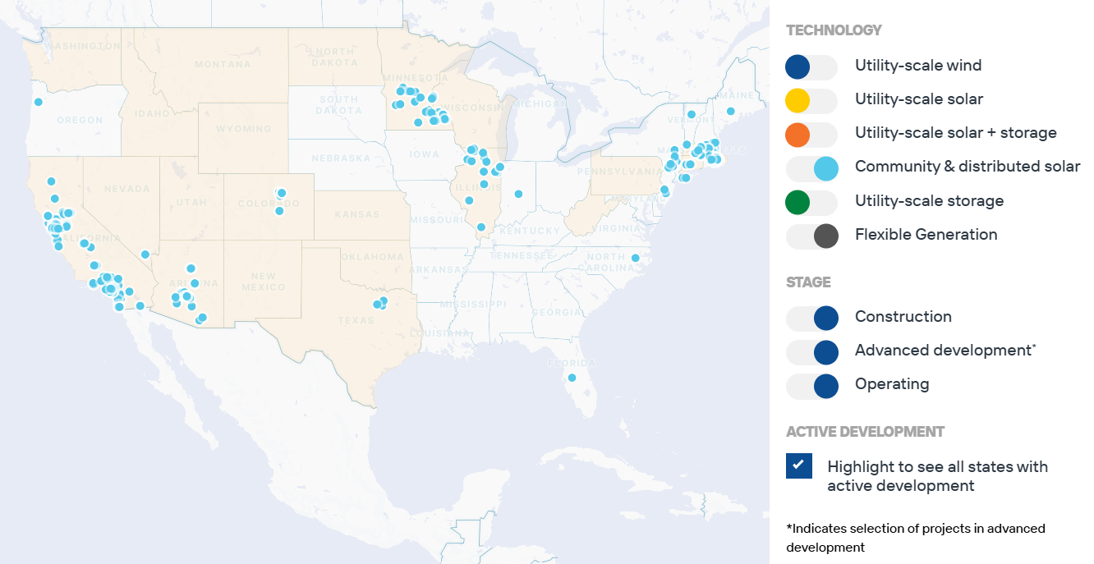
Portfolio Map: Community/Distributed/Flex

